Slide 1
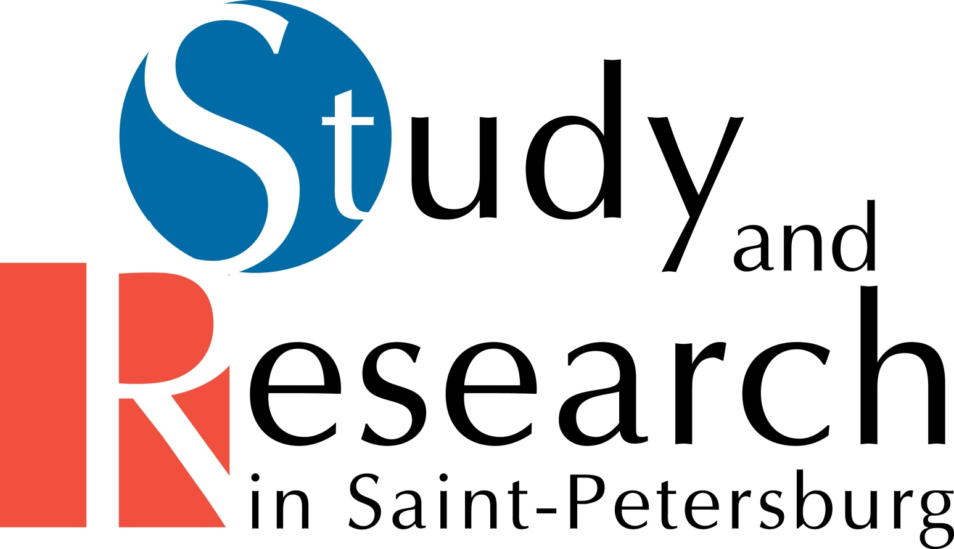
THE SYSTEM OF HIGHER EDUCATION RUSSIA. ST.PETERSBURG

Slide 2
PROFESSIONAL
HIGHER EDUCATION
IN RUSSIAN FEDERATION

Slide 3
Higher education
Professional higher education is governed by the Ministry of Education and Science of Russian Federation.
There are three types of higher education:
University
Academy
Institute
A university covers a broad cross-spectrum of sciences, teaching both undergraduate and postgraduate degree courses, including research and doctoral degrees.
An academy typically specializes in a selective field of science, technology or culture.
An institute provides career-based training in specialist fields of science, technology or culture.

Slide 4
Licensing and accreditation
All higher educational institutions must be licensed or accredited by education authorities.
No independent institution is allowed to provide educational services without a government license.
Accreditation means that the accredited study course meets the national education standards. An accredited institution may issue standardized national diplomas or certificates.

Slide 5
Levels of Higher education in Russian Federation
Bachelor degree, Bachelor - from the Latin. baccalaureus - first qualifying degree acquired by the student after the development of programs of basic higher education (3-5 years of study in high school). According to the results of protection of master's work and taking into account the wishes of the student decides whether to further his education at the university master's program.
Specialist program - a traditional form of Russian higher education. Specialist provides education in the field to give a more narrow specialization.
Masters Degree, Master - (from the Latin. Magister - Head teacher) - academic degree awarded in higher education institutions. Is the second qualifying degree in higher education. Duration of master`s program is 2 years.

Slide 6
Levels of Higher education in Russian Federation
After receiving a specialist degree or master's degree graduates can continue their studies in postgraduate school as well as other educational programs of postgraduate education.
Postgraduate study is a form of post-graduate education and training of persons in order to prepare them for the PhD degree.
Doctorate is forms of professional training in order to prepare them for the scientific degree of DSC.
Externship is independent study studying disciplines according to the basic educational program of higher education in the chosen field (specialty), followed by the current and final certification in higher education.

Slide 7
System of Higher education in Russian Federation
An academic year consists of two parts: the autumn and spring semesters. Each semester is followed by a week of tests and thesis presentations. The tests are followed by exams.
An academic year begins on 1 September and ends on 30 June.
Summer vacations last from 1 July till 31 August.

Slide 8
PROFESSIONAL
HIGHER EDUCATION
IN ST.PETERSBURG

Slide 9
Higher education in St.Petersburg
St.Petersburg, considered to be one of the finest cities in Europe. They also call St.Petersburg Russia's or "Northern Venice" and "Northern Palmyra". These descriptions emphasize the beauty of architectural landmarks that form the signature cityscape.
St.Petersburg today — is treasure-house of art, city-museum, which conserved beautiful architec­tural masterpieces.
Today in St.Petersburg there are:
More than 220 museums
2000 libraries
Over 100 theatres
100 concert halls
50 galleries and expo centers
Over 45 cinemas

Slide 10
Higher education in St.Petersburg
In St.Petersburg students pay for their education or are subsidized by the government.
Today in St.Petersburg:
47 public higher education institutions
44 private higher education institutions
45 state education institutions of secondary professional education
5 private education institutions of secondary professional education.

Slide 11
Higher education in St.Petersburg
St.Petersburg universities offer an extensive choice of educational programs for foreign students.
Сlassic degree courses: Bachelor’s, Specialist’s or Master’s diploma.
Short-term study courses cover many different subjects and are available to everyone at any time during the academic year:
Foundation programs;
Semester programs;
Summer and winter schools
Foreign language courses;
Research internships etc.

Slide 12
Дополнительные программы обучения
University Foundation programs involve intensive Russian plus a whole range of additional subjects that foreign students typically need in order to progress to a Bachelor’s, Specialist’s or Master’s degree course in St.Petersburg.
University Foundation program is carried out 4 directions (profile) correlated to the chosen speciality: engineering, economics, humanities and natural science.
Semester programs are developed in accordance with European standards and requirements and can be integrated in the study plans of students from partner universities and recognized as semester abroad.
Programs duration for students is 1 year (2 semesters): 1-st semester in SPbPU, the 2-d semester in foreign Partner University.

Slide 13
Short-term study courses
Summer schools are organized annually in summer and winter period and include:
a wide range of international short-term educational programs for students, academic staff and specialists in different spheres of science and technology (the courses are taught in English language)
Russian language study (different levels)
various cultural activities.
Foreign Languages Courses is programs for adults and students.
Many St.Petersburg universities offer research internships which can take between 2 and 12 months. Research internships are available in many different fields.

Slide 14
Fields of studying St.Petersburg higher education institutions
St.Petersburg universities provide professional higher education in a broad range of fields and subjects:
Economics and Management
Humanities
Information Technology
Medicine and Healthcare
Technical Sciences
Natural Sciences
Higher educational institutions of St.Petersburg provide training in more than 150 specialties and fields of study.

Slide 15
Number of the universities in St.Petersburg
St. Petersburg State University is the oldest university in Saint-Petersburg.
It was founded in 1724.
There are 47 public higher education institutions in Saint-Petersburg:
19 engineering institutions
6 economics and management institutions
5 medicine institutions
16 humanities and arts

Slide 16
Admission tests
Admission test, exam or interview will be required from a foreign national if he wish to enroll in a Russian higher education institution.
Admission to short-term courses is usually subject to the procedures established by the partner institution or host institution. When there is no competition, the institution may waive admission tests, provided that the candidate has all the requisite qualifications required by the Russian higher education institutions.
Foreign nationals enrolling on the main educational programs are always required to take an admission test.

Slide 17
Higher education in St.Petersburg
CONTACTS:
Tel.: +7 (812) 576-71-60
Fax: +7 (812) 576-77-04
E-mail: knvsh@gov.spb.ru
http://www.study-spb.com
http://www.knvsh.gov.spb.ru
WELCOME TO INSTITUTIONS OF HIGHER EDUCATION
in St. Petersburg!

